Slide 1
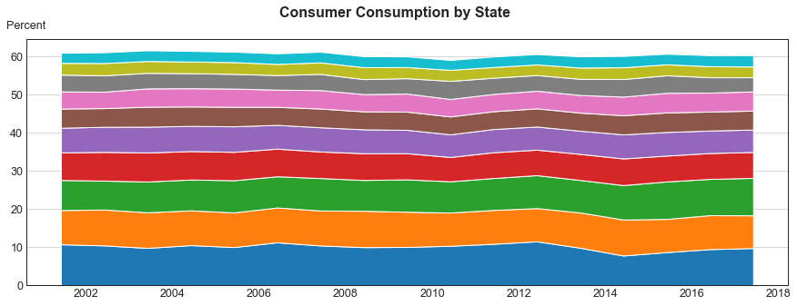
Wisconsin
Indiana
Texas
New Jersey
Pennsylvania
Ohio
Michigan
New York
Illinois
California

Slide 2
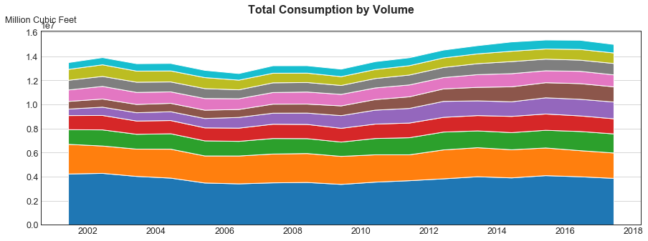
New Jersey
Michigan
Ohio
Illinois
Pennsylvania
Florida
New York
Louisiana
California
Texas

